Slide 1
Systems Administration
Security

Slide 2
Is UNIX/Linux secure
Of course not.
UNIX is optimised for convenience and doesn’t make security easy or natural.
The software that runs on UNIX systems is developed by a large community of programmers.
Most administrative functions are implemented outside the kernel.
Open source distributions may have better security than that of closed operating systems.

Slide 3
How security is compromised?
Social engineering
Human users are the weakest links on the chain of security
Ensure your user community has a high awareness of security threats
Software vulnerabilities
Programming errors are exploited by hackers to manipulate systems into doing whatever they want
Patch the software
Configuration errors
Software is developed to be useful instead of annoying
Balance security and usability

Slide 4
Security tips
Keep the system updated with the latest patches is an administrator’s highest-value security chore
Disable any services that are not necessary
Consider setting up a secure host to act as a central logging machine
Regular system backups are an essential part of any site security plan
UNIX is relatively immune from virus. Just because it is difficult does not mean it is impossible.

Slide 5
A Trojan horse is a program which contains some hidden functionality.
When an unsuspecting person executes the code, the hidden functionality does something to compromise security.
If I write a program to emulate ls, but also mail me a copy of
/etc/shadow then somehow get my code executed as root, I can get a copy of a file I should not have been able to read. I could put my version of ls in /tmp, then hope that the root user has . (dot) in their path before /usr/bin. If the root user is in the /tmp directory and they type ls, then my code is run rather than the system ls (unlikely but possible).
I could use the same trick on non-root users since it is more likely they will have an insecure path.
Alternatively, I could mail my mates my great new program to do X, and put a Trojan horse in it to chmod their home directories to 777 and their profile to 666.

Slide 6
A rabbit is a piece of code which reproduces itself at a high rate and consumes resources intended for other purposes.
This is basically a denial of service attack.
There are few effective defenses but it does require an active account.

Slide 7
Rootkits are programs and patches that hide important system information such as process, disk, or network activity
For example, the hacker might replace ls and ps with hacked version so that certain files and processes will be hidden
Although tools like OSSEC and chkrootkit are available to detect the presence of known rootkits, the time it takes to do a thorough cleaning is very long

Slide 8
Packet filtering and firewall are still powerful tools to block attacks from the outside world
Remember, passwords provide some form of basic protection, simple but useful
Be vigilant!

Slide 9
General philosophy
Effective system security based on common sense
Don’t put files on your system that are likely to be interesting to hackers
Your site’s security policy should specify how sensitive information is handled
Don’t provide places for hackers to build nests in your environment
Set traps to help detect intrusions and attempted intrusions
Religiously monitor the reports generated by security tools
Teach yourself about system security
Prowl around looking for unusual activity

Slide 10
Security policy
The System Administrator will often be expected to develop or assist in the development of IT policy within their organisation.
If the organisation does not have a policy base you need to change the organisational perspective.
If you can’t change their perspective you should consider changing your job

Slide 11
Any organisation should have policy documents to cover each key operational area.
security policy
acceptable use policy
privacy policy

Slide 12
Policy development
Policy development is important to organisations as they define formal mechanisms for handling events.
Policy is dynamic - it will need to be revisited as organisations aspects change.
Policy development should draw on key areas of the organization – it should not be conducted in isolation from major actors
Policies must be documented and be well known by staff in the organisation.
Decisions making should be guided by policy. This is particularly true in security where things can get sensitive.

Slide 13
Policy examples
Acceptable Use Policy (AUP) describes who the legitimate users of network and information technology are. It describes what are acceptable and even unacceptable behaviors. Organisations may have multiple Acceptable Use policies representing varying levels of security (typically tied to job role and seniority).
Privacy Policy describes how the organisation monitors computer and network resources e.g mail, network traffic, web logs, logging etc. Monitoring of such data may be considered a violation of privacy. Such policy needs to conform with State and Commonwealth legislations.

Slide 14
Network Connection Policy defines how resources are connected to one another inside/ outside the organisation and what services they may/ may not offer. This may have implications for business relationships.
Remote Access Policy should describe the risks associated with accessing resources remotely. It should provide details on how to ensure the security of credentials and what to do in the event they are lost.
Log Retention Policy should explain what data is logged and for how long. This policy may be formulated after security policy to aide in the resolution of an incident.

Slide 15
Writing Policy
First establish a basis for writing policy.
The best way to write security policy is by asking questions.
You should be mindful that security depends on having a solid computer and network infrastructure.
Policy depends on the right questions being asked.

Slide 16
What do we have that needs protecting?
Assets can be tangible or intangible e.g. hardware? data? reputation?
What might result from a failure to protect it?
Risks e.g. loss of business, perception, trust etc.
How might it be attacked and by whom?
What channels/ mechanisms may we be compromised
e.g. network, physical security etc.
What is the cost of protecting it? or not protecting it?
– Can we afford to do nothing?

Slide 17
The answers to those previous questions will always vary between organisations and even between organisational units.
(Never fall into the trap of assuming organisations are the same.)
The answers to these questions allow us to conduct a proper risk analysis.
Once we know what the risks are we can develop an appropriate security policy.

Slide 18
Assessing and prioritising risk
Security policy is about prioritising issues according to risk.
Identify all of the resources in the system. This includes hardware, services and data. Identifying threats to the above resources that if realized would cause an interruption to the normal function of the system.
Determining the probability that each risk will occur - calculating the risk.

Slide 19
The threats do not have to be malicious. In most cases they are not.
Non-malicious threats include such things as software bugs, power failures and fire.
A cost/benefit analysis involves:
Determining the likelihood that the event will occur
Assigning a cost to the risk.
How much money will be lost if the risk is realised multiplied by the probability that it will be?

Slide 20
Consider the following Scenario.
If the cost of a fire in a network closet is $50,000 to replace equipment and cabling and the associated down time costs are $150,000 and we can expect that there will be one fire in the closet every 10 years then we can say that the cost of the risk is $20,000 pa.
What typically happens is one or more strategies or measures are priced to significantly reduce the risk.
You should choose the strategy that has the best balance between cost and reducing the risk.

Slide 21
Bad and Good Policy
Here is an example of a Bad Security Policy.
“All passwords shall be a minimum of 8 characters in length and must include a letter, a digit and a punctuation character.”
Why is it bad?- This policy contains specifics and may not scale with the technology/organisational procedures.
A good policy is one that is well worded and not bound to any particular technology/procedure.

Slide 22
“As far as is possible, machines shall be configured so as to enforce the use of passwords which are difficult to attack via brute force search methods.”
Here we can change our definition of difficult in a procedure without changing the policy.
Security procedures should appear in a separate document.

Slide 23
Policy vs Procedure
Policy is usually brief and general
Procedures will change more frequently.
Procedures should be documented in an operations manual which may be attached to or referred to from the security policy.
The procedures are usually longer and far more specific. They describe the how to’s rather than the why’s. Procedure changes when technology and operational aspects change.
The nature of IT requires that procedures need to change often.
Thus the procedures manual requires frequent updates without the need to refer to upper management.
Policy does not generally change over time. It is the founding principals governing why we do things.

Slide 24
The need for management support
For a security program to succeed you need to get the support of management.
The administrator can influence the process, but management typically has the final say as its them who know the business imperatives.
Fundamentally, its a SA’s job to inform them as to the possibilities, risks, threats and benefits. More than that, its important for the SA to be informed of the business imperatives and present solutions that are molded by these business requirements.
Security should be seen as part of an organisations business capability.

Slide 25
Policy models
An organisations security stance can be catergorised by one of the following:
Passive security.
Reactive security.
Proactive security.

Slide 26
Passive security
This is the easiest approach to take. It is also the weakest approach.
Examples of this model include:
Security through ignorance
“what I don’t know can’t hurt me”
Security through obscurity
“what they don’t know can’t hurt me”
Security through complexity
“what I/they don’t understand can’t hurt me”

Slide 27
Reactive security
This approach is better than passive security. However, it is usually too little too late.
Examples of this model include:
Shutting the stable door after the horse has bolted
“we won’t have that problem again”
“he/she won’t do that again”
Systems administrators should design systems which are stable, scalable and secure. If you are not doing this
- you are not doing your job.

Slide 28
Proactive security
Solve the security problem before it is exploited
Hardest to implement
Requires the most work on the part of the SA
Requires the most knowledge on the part of the SA
Requires the most understanding on the part of the SA
Examples of this model include:
Laissez Faire
“what is not forbidden is permitted”
Draconian
“what is not permitted is forbidden”

Slide 29
More to it than writing policy
Many people think that security is about writing policy and putting it on the shelf.
Security depends on procedure. A good administrator will always be on the lookout for changes in the industry, technology or organisation.
The following section outlines things you should consider when working on security.

Slide 30
Logging
Logging does not increase the security of a system per se.
It does give SA s a tool to help you increase the security of systems and detect when a compromise has occurred.
If you log attempts to break in you can strengthen defenses in the area under attack.

Slide 31
Logging should be done to at least 2 destinations. The local machine and a relatively secure log host.
If a person gets root on a machine they can delete the log files, but not on the log host (hopefully).
Alternatively, they may attack the log host first in which case the local machine logs may be your only record of events if the attack fails
With all servers logging to a central syslog server, it becomes easier to correlate events across your company.

Slide 32
syslog
On Unix logging is typically performed by syslog. Syslog allows facilities to be defined.
The logs can be stored on a local host or forwarded to a remote host.

Slide 33
Configuring syslog server
Each system message sent to the syslog server has two descriptive labels associated with it that makes the message easier to handle:
The first describes the function (facility) of the application that generated it. For example, applications such as mail generate messages with easily identifiable facilities named mail.
The second describes the degree of severity of the message.

Slide 34
syslog defines facilities which identify programs that can log.
Facilities include:
auth,
kern,
mail,
cron,
lpr and
several others.
syslog consults file /etc/syslog.conf to configure the daemon.

Slide 35
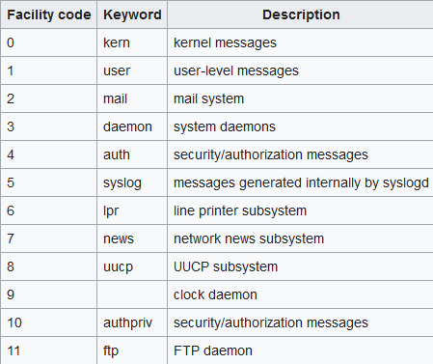
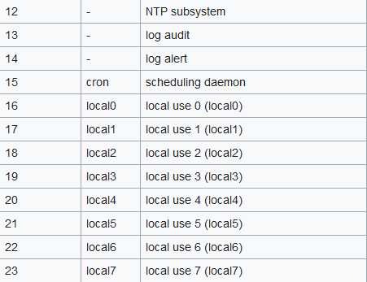
Syslog facility

Slide 36
The log files are usually kept in /var/log directory
Sample of syslog.conf file
*.debug /var/log/messages
The above captures all messages from debug severity and above in the /var/log/ messages file.
.info;mail.none;authpriv.none;cron.none
/var/log/messages
In the above, all messages of severity “info” and above are logged, but none from the mail, authentication facilities/subsystems or cron.

Slide 37
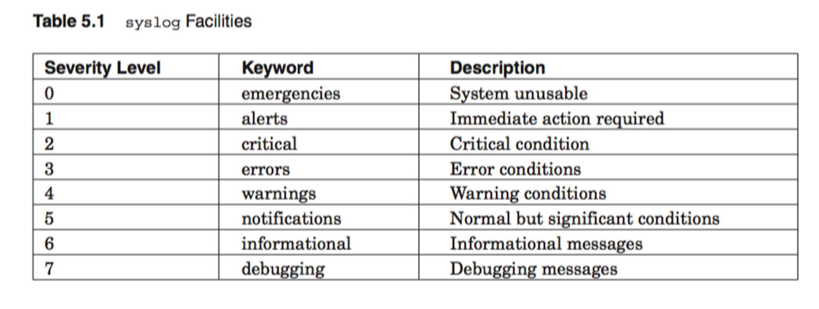



Slide 38
For each facility we may specify where to put the log data via a path.
We can also discriminate on each facility using severity levels.
Examples include
info,
err,
crit,
emerg,
alert.
It is also possible to configure syslog to accept syslog messages from remotes clients

Slide 39
Syslog actions
Action | Meaning
Filename | Appends the message to a file on the local machine
@hostname | Forwards the message to the syslogd on hostname
@ipaddr | Forwards the message to the syslogd on host ipaddr
| fifoname | Writes the message to the named pipe fifoname
user1,user2, … | Writes the message to the screen of users if they are logged in
* | Writes the message to all users who are currently logged in

Slide 40
What to log – that is the question
Logging too much data is counter-productive since it becomes harder to identify the important log entries.
There are things which you should always log. Below is a list:
Su attempts (switch user).
Network connections (tcpd does this).
Failed logins.
Rejected file system mount operations.
Transaction on services e.g. Mail, FTP etc.

Slide 41
Typically we would use the cron job scheduler to check for anomalies in the logs.
It is not practical for a SA typically to read the logs because of the volume of text.
Whatever logging level you choose, you should automate the monitoring of logs.
swatch and logsurfer are 2 shareware utilities for this task. They can inform you (via pager or mail) when they detect a problem.

Slide 42
Never completely trust your logs
The UNIX syslog daemon will accept log requests from anyone and, in the network case, from anywhere. This means people can, potentially, insert bogus log messages into your logs.
Similarly, a hacker can flood a host with log messages to cover illicit activity.
You should be able to detect this, however, by appropriate log filters.
One technique is to flood a log host for a few hours to fill the filesystem where the log files are kept. Then launch an attack.
If it succeeds, it will be possible to modify the local log files. The administrator will know that something occurred, but it will be harder to track the intruder down.

Slide 43
Human factors
You can never predict users. Users have this ability to effect security through behaviors. We have already covered passwords in a previous lecture. There are many others.
Examples include:
People storing sensitive information on insecure machines for convenience.
Users letting their boy/girl friend use their account.
Users installing their own switches in their offices (not any more).

Slide 44
When setting up site security, too many people focus exclusively on the external threat. They believe firewalls etc are vital, but internal security is not considered.
It is best to assume a hostile user base even when that is not the case.

Slide 45
Physical security
As a general rule, no system is secure against an intruder who has physical access to the machine. This is often forgotten.
An intruder can:
boot from alternate media.
remove (or copy) disks or tapes.
install additional hardware. (check out MIT Aaron Swartz case)
Machine rooms need to be secure and the data they house needs to be protected.
This can be very difficult especially in environments where you have contractors.

Slide 46
Where possible you should design your machine room with this in mind.
You should also, where possible, exploit some of the technologies in the actual machine. (Check out firmware password as an option)
Servers need to be housed in secure environments.
Auditors may insist on good physical security, as they should. In extreme cases, it can be better to destroy resources when physical security is compromised.

Slide 47
Back ups
Backup strategies are an important adjunct to system security since, if a compromise is detected, trusted data will have to reloaded from backups.
Once a machine is root compromised - that’s it.
You can not trust the machine and its data any more.
However sometimes people when they attack organisations go after the backups.
There should be procedures to make sure things work -
this is disaster recovery policy.

Slide 48
Data integrity check
Ideally, all of the system components not required to be modified would be read only and not modifiable even by root. This is difficult to achieve.
Integrity checking of important files one of the best ways to detect intrusion.
The open source utility tripwire or ace compute file checksums and compares with previously computed values and thus detects when files change.

Slide 49
Ideally, checksums should be stored where an intruder can not alter them (write once devices).
Of course, the intruder may replace your version of tripwire with hacked version – or replace a shared library with a version with Trojan code but this type of intrusion is sophisticated and rare.
Integrity checking is also a useful SA tool for detecting policy violations. Examples of this include installing software without updating software logs.

Slide 50
Encryption
Encryption is a basic tool of system security and should be used a lot more than it is.
It is not used as much as it should be because of its high cost (in CPU) and difficulties of administration (PKI).
Particularly sensitive information should be encrypted, especially for network transmission.

Slide 51
Cryptographic hashes
A hash function takes data (called the message) uses a cryptographic key to encode the message producing a condensed representation called the message digest
It is hard to reverse
Is applied in different ways:
To provide proof of authenticity (e.g. IP Security (IPSec) uses symmetric keys)
Provide authentication by generating one-time and one way response (password)
To provide message integrity check (digitally signed contracts) and using public key infrastructure certificates to enable secure site using a browser.

Slide 52
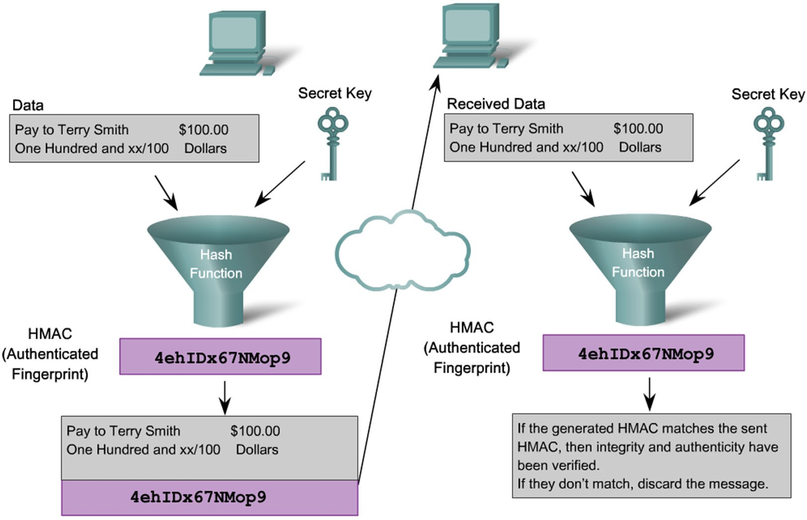

Slide 53
Confidentiality through encryption
Layers of encryption
Layer 2 proprietary methods
Layer 3 – IPSec
Layer 4/5 – Secure Socket Layer (SSL) or Transport Layer Security (TLS) provides session layer confidentiality
Application layer confidentiality – secure email, secure data base session
Two classes of encryption algorithm
Symmetric algorithm – identical keys are shared between sender and receiver
Asymmetric algorithm - different keys are used to encrypt and decrypt messages.

Slide 54
Block ciphers and stream ciphers
Block ciphers transform a fixed length of plain text into blocks of cipher text 64-128 bits long. The plaintext can be retrieved by applying the secret key in reverse
Stream ciphers encrypt text one byte at a time

Slide 55
Asymmetric Encryption – Public Key Infrastructure (PKI)
Asymmetric key algorithm does not require exchange of keys.
Protocols that use asymmetric encryption include:
Internet Key Exchange (IKE) used in IPsec VPN
Secure Socket Layer or IETF standard TLS
SSH
Pretty Good Privacy

Slide 56
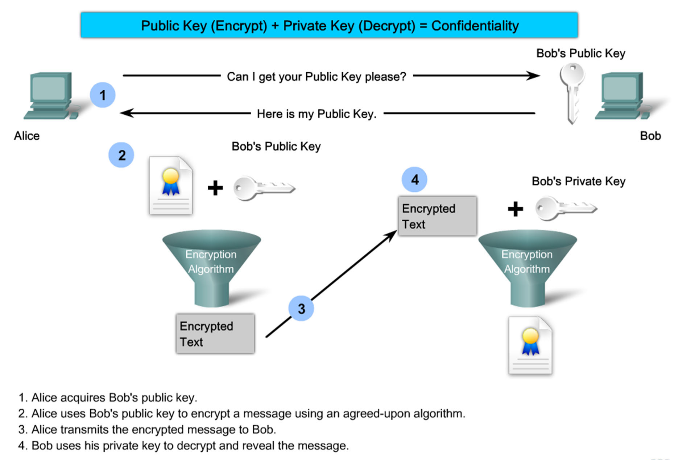

Slide 57
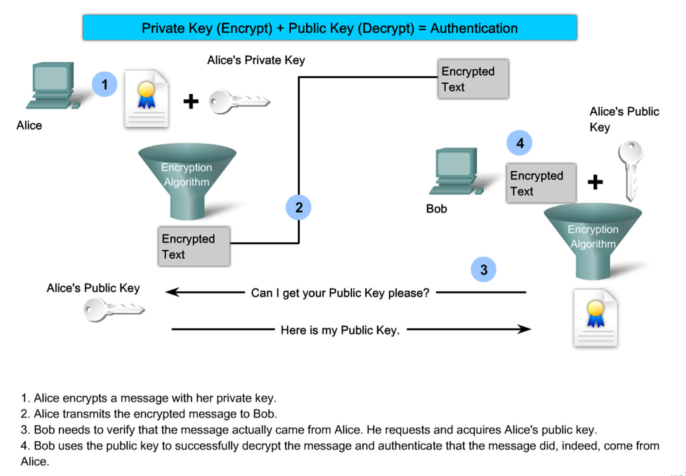

Slide 58
Digital signatures
Digital signatures
enable unique proof of a data source which can only be generated by a single party
authenticate a user by using the private key of that user and the signature it generates
to provide authenticity and integrity of PKI certificates
to provide a secure timestamp using a trusted time source

Slide 59
Certificate Authorities
X.509 is a well known standard that defines basic PKI formats such as certificates and certificate revocation.
In order to administer PKI a number of authorities exist to issue keys.
Single Root authorities
Hierarchical CA Topology
Cross certified CA topology.

Slide 60
Trust and IP/DNS Spoofing
Spoofing refers to the general practice of forging either sources of information or the results of queries.
Because most of the principles of trust across networks involves knowing the source of the packets, forging packets is an effective way of bypassing system security.
This is obviously more important as the level of trust granted a machine increases e.g. DNS Servers need to be secure leading to DNSSec

Slide 61
Kerberos
Kerberos was designed to solve some of these problems.
Users get “tickets” which can be passed around between machines so that servers can authenticate requests.
Tickets are just like passwords, except that they can be safely passed around the network and are immune from sniffing (because user names and password are not transferred).
Tickets may be passed around because they are always encrypted; with keys that are only known to the authenticated users and with the current time.

Slide 62
Back to the Human Aspects of Security -focussing on the SA!
We have already covered the potential security compromises generated by users. (These include: bad choices of passwords, letting other people use their account, leave sensitive information in insecure places such as email, introducing foreign/non-authorized equipment into the corporate environment)
System Administrator errors also play a part
Simple typing errors
Bugs in code
Careless system configurations
Bad system default settings

Slide 63
Examples of carelessness include:
System Administrator runs a script to dump the password and shadow files for some reason, then forgets to chmod them to 600.
Files left laying around containing encrypted passwords.
User finds and runs crack.
These sorts of problems are much more common than attacks against encryption keys.

Slide 64
What Should an Administrator Do?
Ensure physical security.
Stay on latest OS release. Stay on latest patch releases.
A large number of break-ins occur exploiting bugs that have been fixed by new OS releases or patches.
Experience indicates that staying on current OS and
patch levels is the single most important step in ensuring system security.
After OS install, audit machine security.
Remove unnecessary services.
Check permissions on important files/directories.
Set up logging properly and monitor important logs.
Know and control your trust relationships.

Slide 65
Useful information sources
Administrators need to keep up to date with the world. Here are some common sites/ email addresses which can keep you informed about security.
CERT
AUSCERT
www.cert.org www.auscert.org.au

Slide 66
Network security
Network security is a set of measures to mitigate risks to the network and devices using the network.
Network security allows you to build layers of protection.
You can erect multiple hurdles or “safety nets” to make life difficult for an attacker or to catch unexpected behavior at an early stage.

Slide 67
A rationale for network security
Are all devices on your network as secure as they should be?
Most likely you will not have control over every device using the network. (Think BYOD – Bring your own device)
Often you will not have the resources (time and knowledge) to make every device secure.
Some devices just cannot be made sufficiently secure.
There are certain threats that cannot be addressed without network security

Slide 68
Threats
The four basic categories of threats to networks and devices using networks are:
Eavesdropping
Spoofing (impersonation)
Modification of network communications
Denial of service
These are often used in combination

Slide 69
Eavesdropping
An attacker listens to or watches the traffic on the network.
This is a threat to confidentiality.
The attacker may capture data that is confidential or secret.
– (eg passwords)
Think Wireshark…

Slide 70
Spoofing
An attacker impersonates a user or device by faking a protocol attribute that is used in an authentication process.
This can be used to eavesdrop (man in the middle).
Another common case is faking the source address on UDP packets – research this one for the wiki

Slide 71
Modification of network communications
An attacker hijacks communications between two devices and modifies the messages to influence the behavior of one or both parties.
This is a threat to data integrity.

Slide 72
Denial of Service attacks
An attacker finds a way to cause a network service to stop functioning as expected
This is a threat to accessibility.
Often this is achieved by flooding the network with messages (classic is TCP SYN messages with fake IP source addresses).
This is a common prelude to a spoofing attack.

Slide 73
Determining what is required
Computing security is really about ensuring that the system operates as expected (the way it was designed).
Further, it attempts to limit the magnitude of the damage when things do go astray.
To ensure consistency, clarity and that some body is assigned responsibility, security requirements should be codified in a “Security Policy” document.
What level of security does your network require?
A systematic method for answering this question is to conduct and risk analysis followed by a cost/benefit analysis.
We have established this is an important step.

Slide 74
Network security measures
Network security measures can be implemented:
at the end host,
networking devices (routers, switches, etc)
Generally there are two things that can be done to improve security.
Restrict who and what can access your network (both physically and otherwise).
Being careful about how data is transmitted on the network.

Slide 75
Measures for end devices
It makes sense to restrict access to services to only the people that require them (and that hopefully can be trusted).
One method of limiting access to services is to use authentication.
Passwords.
Public key authentication (signatures).
One shot passwords.
Kerberos

Slide 76
xinetd
Use of xinetd can limit access to services (applications) through ACL.
xinetd - listens for incoming requests over a network and launches the appropriate service for that request. Requests are made using port numbers as identifiers and xinetd usually launches another daemon to handle the request.
xinetd features access control mechanisms such as TCP Wrapper ACLs, extensive logging capabilities, and the ability to make services available based on time. It can place limits on the number of servers that the system can start, and has deployable defense mechanisms to protect against port scanners, among other things.

Slide 77
Measures for network devices
Physical security is important when it comes to networks for a number of reasons:
Network infrastructure is often quite large and covers a large area.
Attacks can be made against the network if the attacker has physical access to the infrastructure.
Devices should be physically secured and authenticated secure.

Slide 78
Data integrity
Many protocols have been designed without much thought to security.
This is true for IP in general.
Most older protocols are susceptible to eavesdropping, spoofing, insertion attacks and denial of service.
Rear guard actions include
Secure DNS – DNSSec
Secure IP - IPSec
Secure Shell – SSH (replaces Telnet)

Slide 79
Virtual Private Networks
A virtual private network is a tunnel over an insecure network connecting two or more trusted networks using the techniques just described.
Specially designed routers are normally used to construct a VPN
Two types of VPN –
Site to site VPN – VPN tunnel (encrypted) established between two sites using the public internet.
Remote Access VPN – Host has VPN client software which uses the public Internet to send it to the destination network VPN gateway.

Slide 80
Packet filtering
Access control lists
Networking devices that understand the transport protocols and sometimes higher (typically routers) can decide which individual protocol data units (packets) it will allow into or out of the network.
This can be used to permit or deny access to services based on rules.

Slide 81
Firewalls
Firewalls are systems that exercise a high level of control over what data enters and leaves a network.
Typically they involve a couple of packet filters and one or more application proxies (commonly referred to as bastion hosts).
Their role is to drastically reduce the ways an intruder can use to attack your systems.

Slide 82
Intrusion Detection Systems
Firewalls are not effect in protecting networks from worms, viruses malware etc.
Analyzing logs is one measure but is after the event, complex and not scale.
IDS passively monitors traffic by analyzing a copy of the traffic stream.
Advantage is that IDS does not negatively effect actual traffic flow.
Its disadvantage is that cant stop malicious attacks from reaching the target before being able to respond

Slide 83
Intrusion Prevention Systems (IPS)
In contrast IPS in contrast does not allow packets to enter the network until it has been analyzed.
An IPS monitors Layer 3 and 4 traffic and analyses the content and the payload for embedded attacks.
For example, Cisco’s IPS uses a combination of detection technologies, signature-based, profile-based and protocol analysis.
Advantage is that single-packet attacks can be foiled
Disadvantage is that network performance can suffer if not configured properly or inappropriate choice of IPS has been made.

Slide 84
Incident response plan
Somehow you’ve detected that an attack has occurred or is occurring now!
What are you going to do about it? Be prepared.
There are several options available when you discover an attack. The right decision will depend on the type of attack and the business requirements of your organization.
Is it more important to get the systems back to normal?
Is it important to attempt to discover who the intruder or attacker is?
Is it important to work out exactly what the attacker did?
Does evidence need to be collected for legal reasons?
Who should be notified? Report the incident to the authorities or keep it a secret?
Devise and communicate a recovery plan. It is important to explain what happening (but where appropriate you should omit details).

Slide 85
Final exam
Date: check your exam timetable
Venue: on campus
Duration: 3 hours
Items permitted: calculator
Format:
Part A: MCQ (20 questions worth 20 marks)
Part B: short answer (10 questions worth 20 marks)
Part C: planning and design (2 questions worth 10 marks)
Answer all the questions

Slide 86
How many marks do I need?
As many as possible!
A minimum of 20 (out of 50) is needed to avoid TF.
Supplementary exam will be offered on a case-by-case basis.

Slide 87
Q & A
Do I need to remember all commands?
No, but you need to remember some most basic ones, e.g., ping www.google.com
Do I need to remember all the files and their formats?
No, but you need to remember some most basic ones, e.g., the password file.
How do I prepare for the exam?
Everyone has his/her own way to prepare for the exam. It is suggested to focus on lecture notes/lab notes/assignments.
What if I have questions before the exam?
Contact me to clear all the questions you have.

Slide 88
Q & A
I don’t feel well on the exam day, what should I do?
Do not attend the exam and apply for AC. If you have sat the exam, your AC will not be approved unless you have been sent to the hospital by an ambulance during the exam.
I have been offered an AC supplementary exam but I feel sick on the supplementary exam day, do I get another supplementary exam?
No, you may be offered a “late withdrawal without academic penalty”.

Slide 89
Sample questions
Write a shell command to display all files in /etc.
What is the difference between the absolute path and relative path in UNIX? How do you differentiate an absolute path with a relative path?
Compare and contrast LVM with disk partitioning. Outline the strengths and advantages of using LVM.

Slide 90
Good luck!

